Slide 1
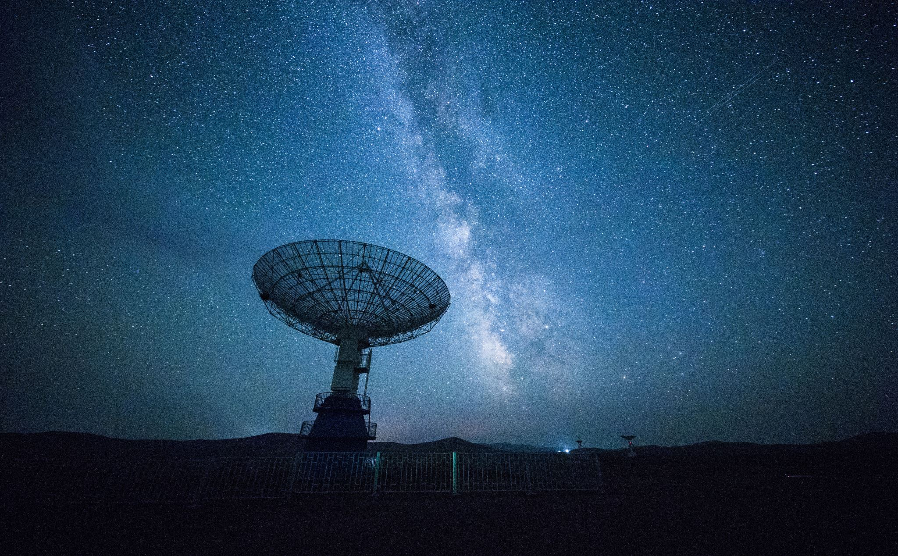
Understanding Redshift: The TIME-TRAVELLING Science

Slide 2

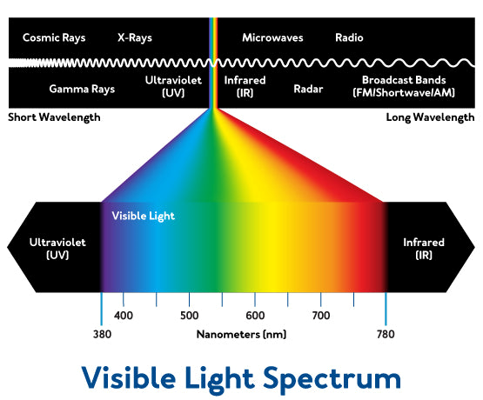
Basics: What is light?
Light is a form of electromagnetic radiation that travels in waves of varying lengths.
The longer or shorter the wavelength of light, the higher or lower it is on the spectrum.
Light that we can see is in something called the visible light spectrum and it ranges from short wavelengths, that produce colours like purple and blue, to long wavelengths, that produce colours like red and orange.

Slide 3
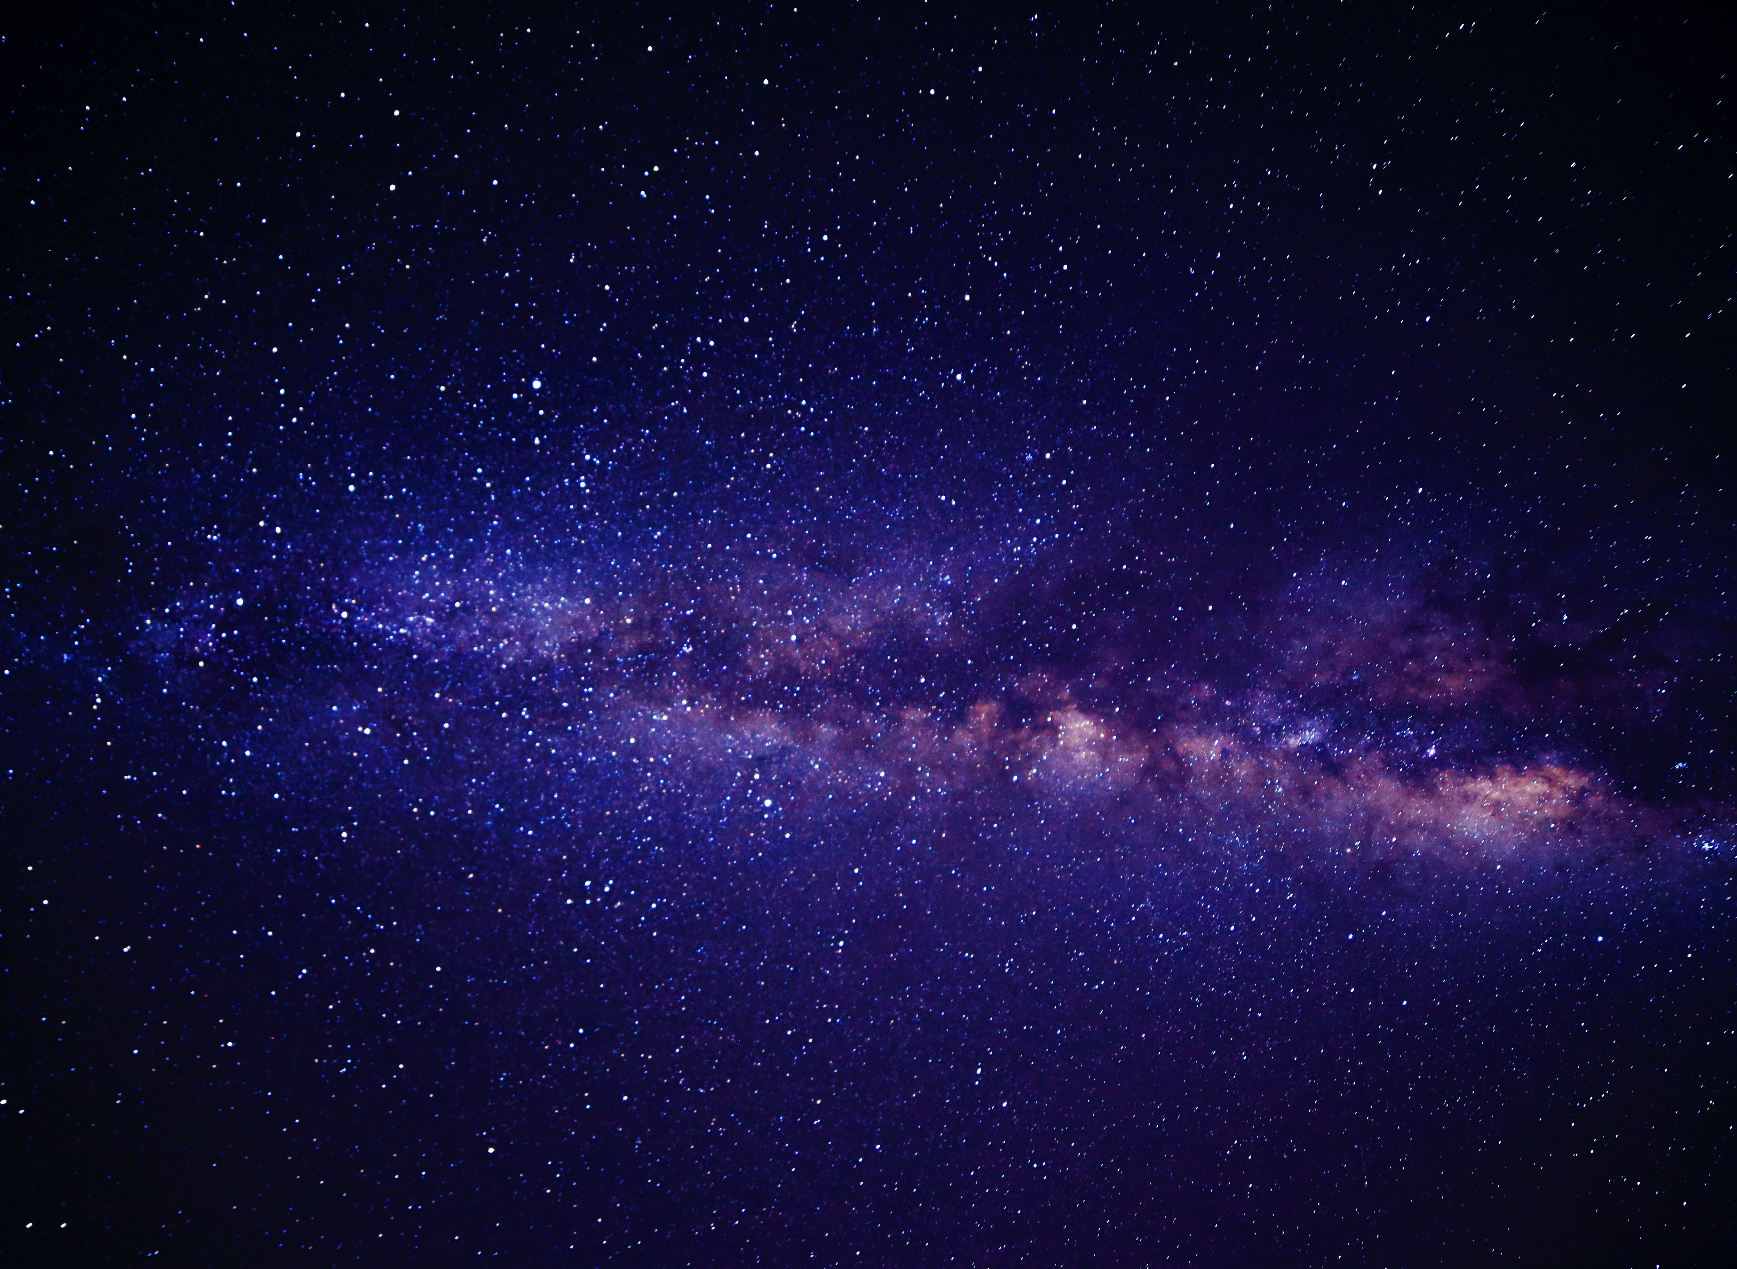
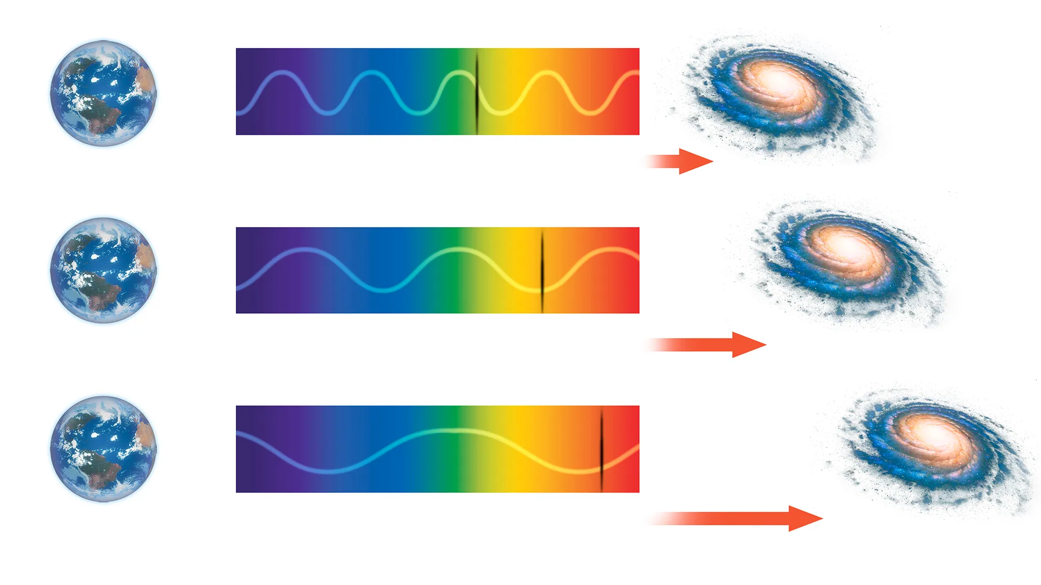
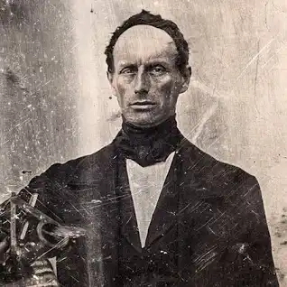
What do light wavelengths show?
The further a wave travels, the more stretched out its wavelength becomes.
As a wave lengthens out, its place on the spectrum shifts.
When a wave travels a long distance, to the human eye it will appear to be near the red end of the light spectrum.
Simply speaking, this is why galaxies and stars that are moving further away from us give back light that is shifted towards red in colour.
This was discovered by Christian Doppler and was included in his principle, called ‘the Doppler effect’.

Slide 4
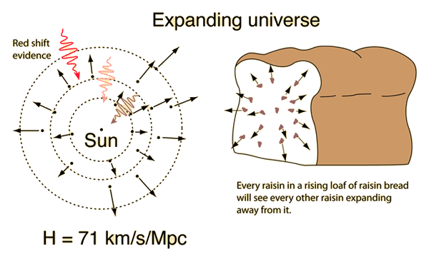
How is age determined?
Age of a celestial object is determined by light received.
Hubble’s law was what deduced this way of calculating age. It states that a celestial body’s redshift is directly proportional to its distance.
Using this fact scientists can use light received to determine age.
Therefore, Doppler effect is used in tangent with Hubble’s law to calculate age

Slide 5
Conclusion
Redshift is a concept within astronomy that plays a fundamental role in our understanding of the universe.
Often observed in astronomical objects, redshift refers to the shift of light towards a longer wavelength.
Redshift is used in tangent with Hubble’s law and the Doppler effect.
This phenomenon is the key supporting evidence for the expansion of the universe theory and provides valuable insight into its vastness and evolution.
Using redshift, we were able to discover that the universe is expanding, moving further and further away.

